Slide 1
The Cycle Manager
Glenn Larson

Slide 2
System Background
Key Functions:
Point of Sale System
Manage Products and New Bikes
Enter/Edit/Look-up Customer
Create/Update Service
Create and Manage Service Tickets.
Employee Clock-In/-Out

Slide 3
Application Architecture
C#
Visual Studio 2010
Access
3 layer
Presentation
Business Layer
Data Access

Slide 4
Requirements Models
Actor –The Only Actor Is The Employee
Use Case Diagram
Employee
Managerial System
Sales and Service System
Enter Service Ticket
Use Case Description
Enter Service Ticket

Slide 5
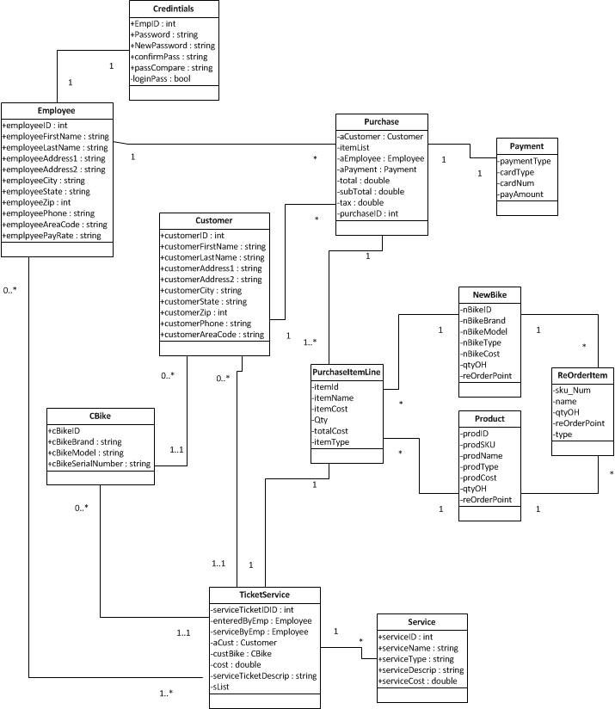
Domain model Class Diagram

Slide 6
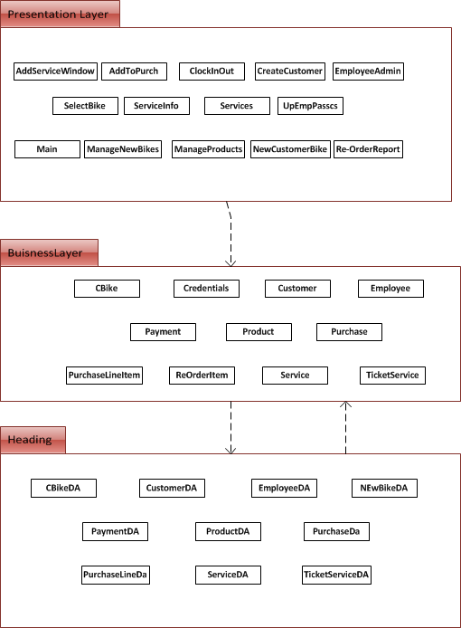
Package Diagram

Slide 7
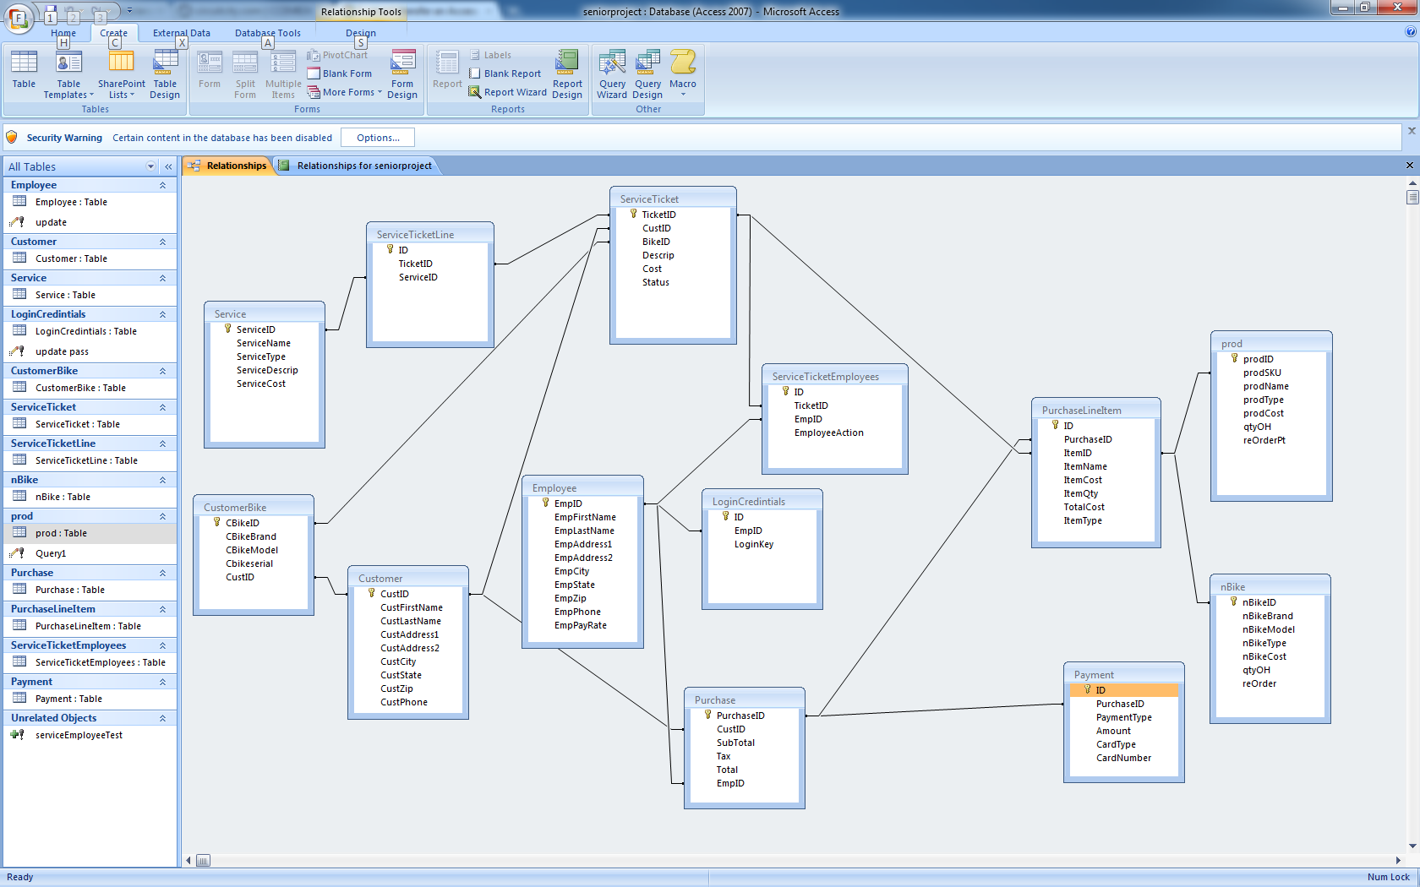
Database

Slide 8
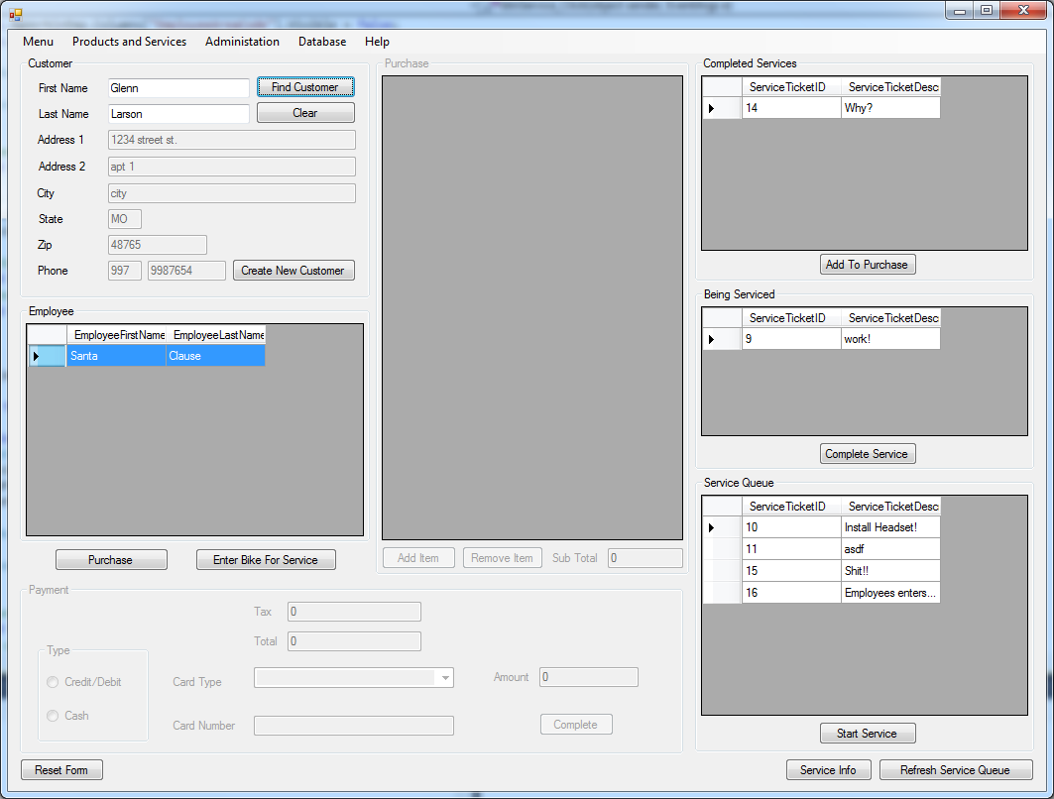
Enter Purchase Story Board
Employee enters customer first and last name then clicks find customer. Customer
Information appears and then employee selects their name from working employee list
and selects Purchase

Slide 9
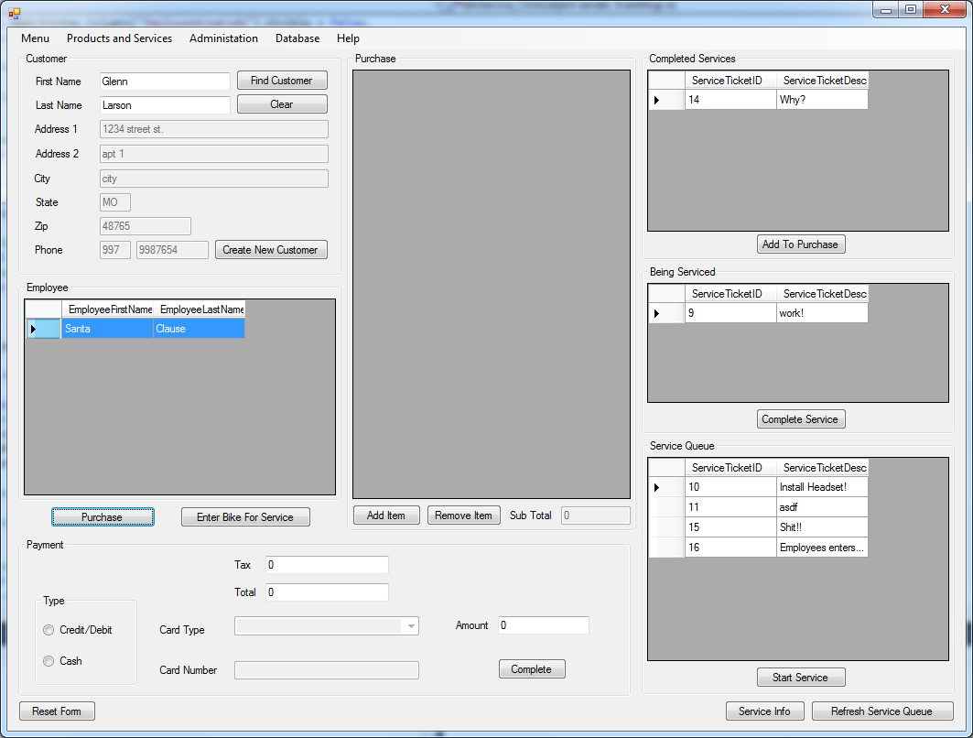
Story Boards
The Purchase group box and the payment group box will become active.
The Employee then clicks add item button.

Slide 10
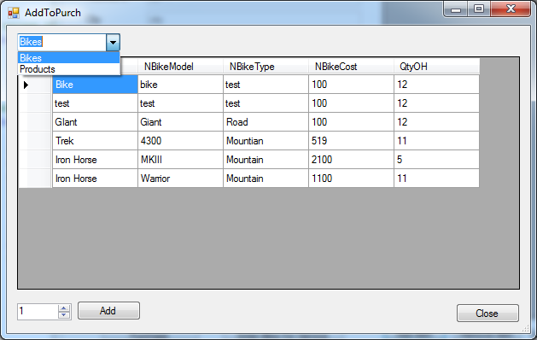
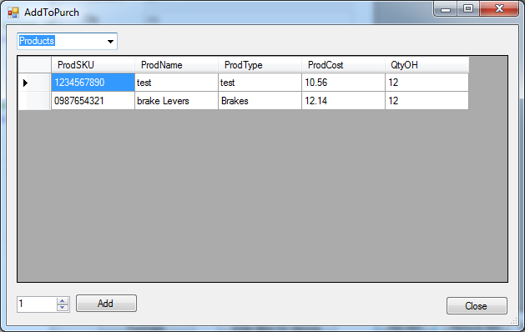
Story Boards

Slide 11
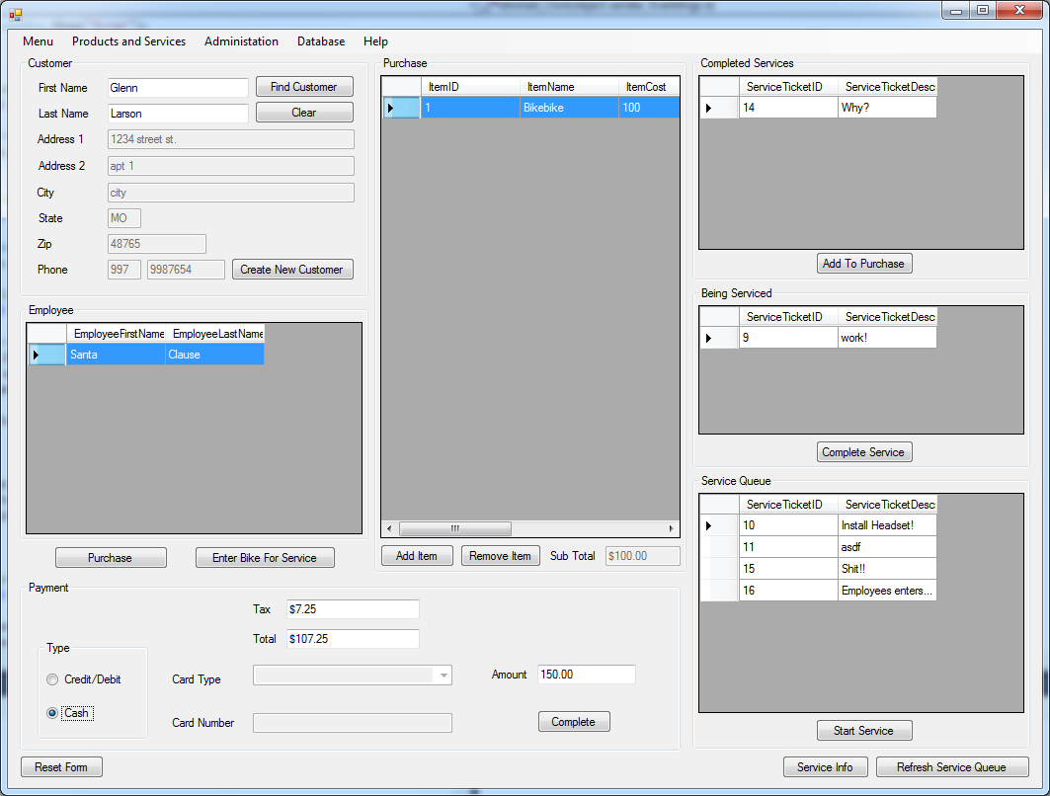
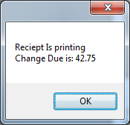
Story Boards
Item gets added then employee enters payment information and clicks complete

Slide 12
System Controls
Used Try Catches To catch and handle errors.
Message displayed to user informing them of error
Detailed message written to console
FormatException
NullReferenceException
OleDBException
If Statements to control certain functions if certain requirements aren’t met
Can’t add services till bike is selected when entering service ticket
Can’t complete entering service tickets without adding a service
Text Validation
validate that text boxes aren’t left blank
Validate text in text boxes doesn’t contain invalid characters
Used regular expressions
Throw format exception if it doesn’t pass

Slide 13
System Controls Text Validation
public static void validateStringAlphaNumeric(string s, string fromInput)
{
Regex r = new Regex("^[a-zA-Z0-9\\s]*$");
if (s == "")
{
throw new System.FormatException(fromInput + " Cannot Be left Blank");
}
else
{
if (r.IsMatch(s))
{
}
else
{
throw new System.FormatException(fromInput + " Contains invalid characters");
}
}
}

Slide 14
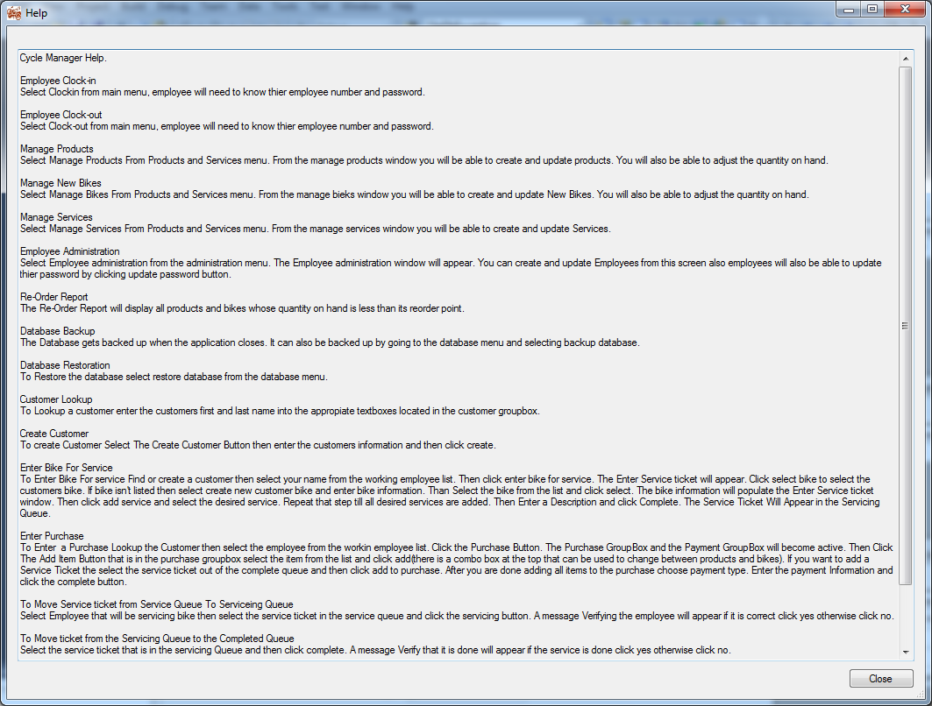
System Controls

Slide 15
Receipt Print out

